Slide 1
Protein binding sites of other let7 miRNA gene families
서창완
1. List of let7 miRNA gene family in human genome
1. Grep mirlet from annotation.gtf
2. Read as pandas dataframe
3. Filter feature "transcript"
chr | start | end | strand | attribute
chr9 | 41448012 | 41448107 | + | Mirlet7a-2
chr9 | 1.06E+08 | 1.06E+08 | + | Mirlet7g
chr10 | 1.23E+08 | 1.23E+08 | - | Mirlet7i
chr13 | 48689488 | 48689590 | - | Mirlet7d
chr13 | 48691305 | 48691393 | - | Mirlet7f-1
chr13 | 48691655 | 48691748 | - | Mirlet7a-1
chr15 | 85590804 | 85590898 | + | Mirlet7c-2
chr15 | 85591520 | 85591604 | + | Mirlet7b
chr16 | 77396545 | 77396638 | + | Mirlet7c-1
chr17 | 18050614 | 18050706 | + | Mirlet7e
chrX | 150695342 | 150695424 | + | Mirlet7f-2

Slide 2
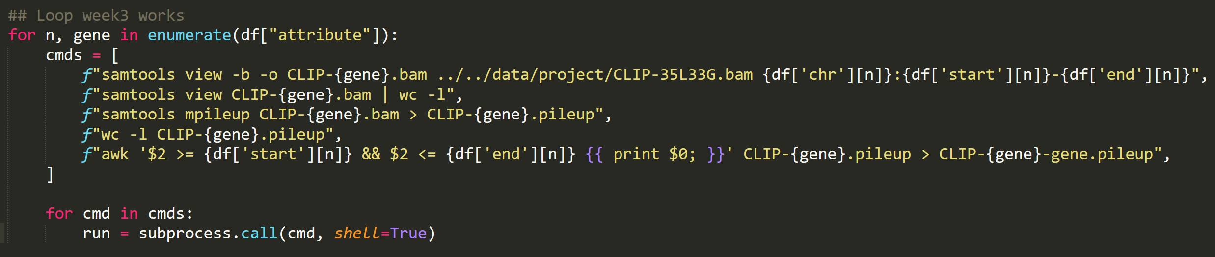
Protein binding sites of other let7 miRNA gene families
서창완
2. Generating bedgraph files for all Mirlet7
Generalize week3 commands
Iteratively call with subprocess

Slide 3
FunID – Fungal Identification Pipeline
서창완
FunID Roadmap
~1/28
~2/17
~3/10
~May
Beta build
Dataset generation
Manuscript
Submission

Slide 4
FunID – Fungal Identification Pipeline
서창완
FunID Roadmap
~1/28
~2/17
~3/10
~May
Beta build
Dataset generation
Manuscript
Submission
Tax-credit / 2 real datasets

